Slide 1
Modeling & Analysis
Self-defined Homework
By TANMOY DAS

Slide 2
Problem Statement:
Tasks | Processing time | Due dates
A. Abstract submission of Thesis work * | 20 | 22
B. Preparation for term final * | 15 | 15
C. Solve family matters * | 10 | 105
D. Making tutorials on GRE | 11 | 91
E. Complete Wedding photography course | 7 | 45
F. Publish paper on journal | 26 | 32
G. Tour with MOM | 12 | 44

Slide 3
Procedure:
Consider the tasks listed table above for upcoming months. I need to identify the optimal scheduling technique to perform all the tasks.
SPT
EDD

Slide 4
Scheduling Technique:
Applying Shortest Processing Time (SPT),
The sequence is {E,C ,D ,G ,B ,A ,F }

Slide 5
SPT | Processing time | Total completion time | Due dates | T_{i}
E | 7 | 7 | 45 | -38
C | 10 | 17 | 105 | -88
D | 11 | 28 | 91 | -63
G | 12 | 40 | 44 | -4
B | 15 | 55 | 15 | 40
A | 20 | 75 | 22 | 53
F | 26 | 101 | 32 | 69

Slide 6
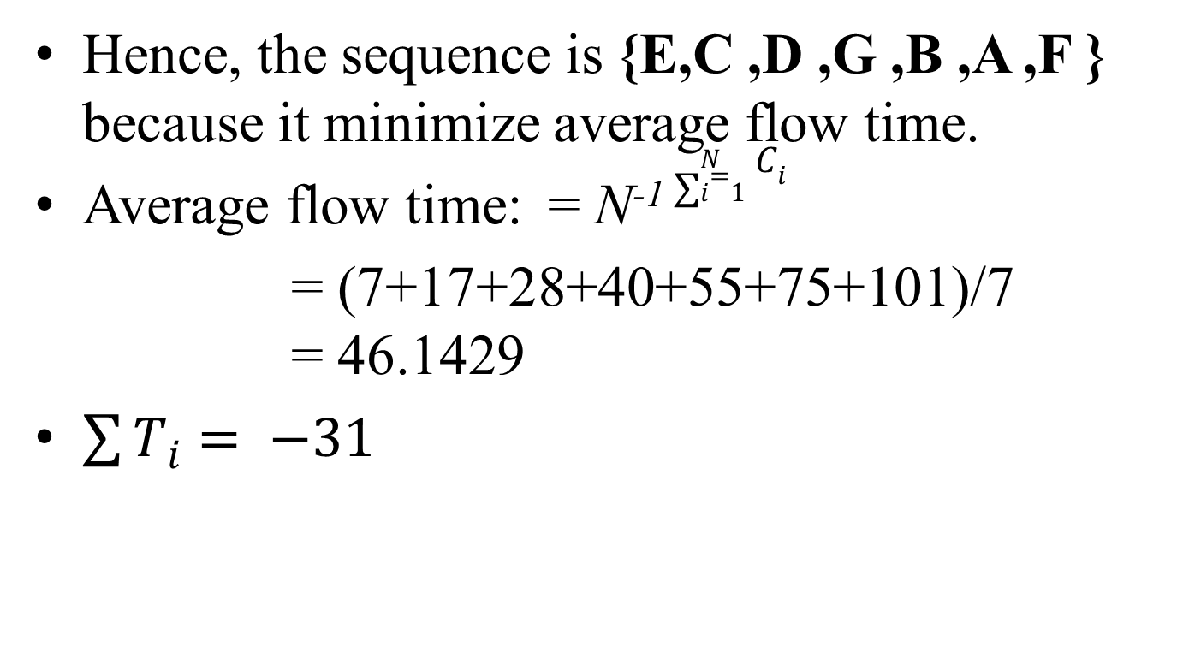
Hence, the sequence is {E,C ,D ,G ,B ,A ,F } because it minimize average flow time.
Average flow time: = N⁻¹ $\sum_{i=1}^{N}{C_{i}}$
= (7+17+28+40+55+75+101)/7 = 46.1429
$\sum{T_{i}= −31}$

Slide 7
Figure 1.1: Gantt chart for the Problem considering SPT

Slide 8
Applying Earliest Due Date (EDD)
The sequence is {B, C, A, D, F, G, E }

Slide 9
EDD | Processing time | Total completion time C | Due dates, d | Lateness value L_{|k|} = C_{|k+1|} - d_{|k|}
B | 15 | 15 | 15 | 0
C | 10 | 25 | 105 | -80
A | 20 | 45 | 22 | 23
D | 11 | 56 | 91 | -35
F | 26 | 82 | 32 | 50
G | 12 | 94 | 44 | 50
E | 7 | 101 | 45 | 56

Slide 10
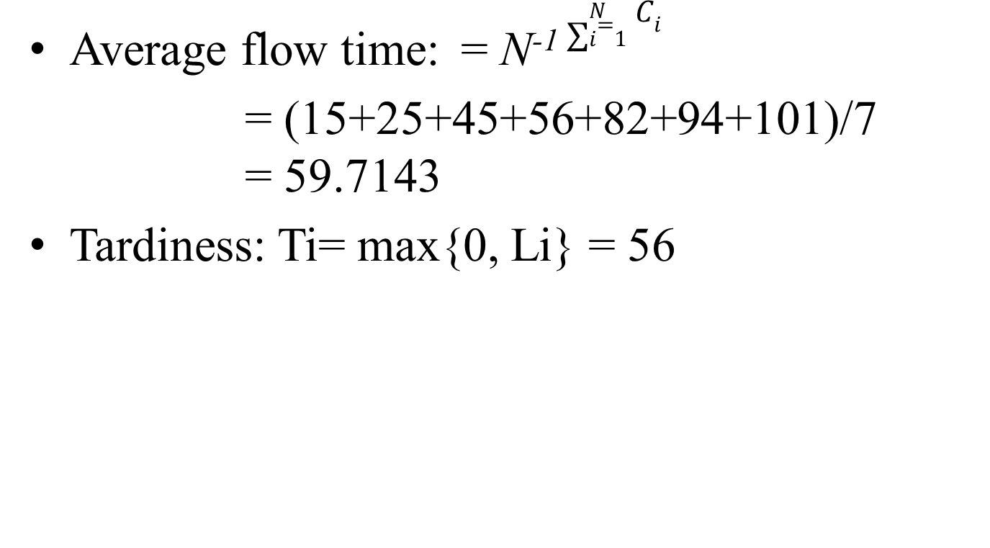
Average flow time: = N⁻¹ $\sum_{i=1}^{N}{C_{i}}$
= (15+25+45+56+82+94+101)/7 = 59.7143
Tardiness: Ti= max{0, Li} = 56

Slide 11
Figure 1.2: Gantt chart for the Problem considering EDD

Slide 12
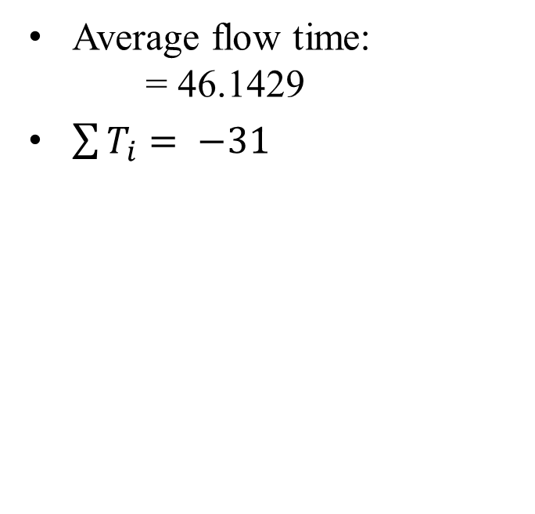
Result:
Comparing SPT & EDD:
SPT
EDD
Average flow time: = 46.1429
$\sum{T_{i}= −31}$
Average flow time: = 59.7143
Tardiness: = 56

Slide 13
Discussion:
I must maintain the due date for task A,B & C. But, for rest of them due date may be relaxed.
Average flow time is minimum when we use SPT
Hence, I should choose SPT over EDD

